Slide 1



Introduction to
Big Data
May, 2023
Dávid Szabó

Slide 2
AGENDA
1
Motivation
2
Hadoop
3
Spark
4
Workshop

Slide 3

Motivation

Slide 4
WHY BIG DATA?
NoSQL
How to store data so that
… some queries can execute efficiently
Limited ad-hoc queries
Big Data
How to store ANY DATA as is
How to run ANY QUERY (analytics)
Realtime queries
Execution time: milliseconds, seconds
Non-realtime queries
Execution time: minutes, hours

Slide 5
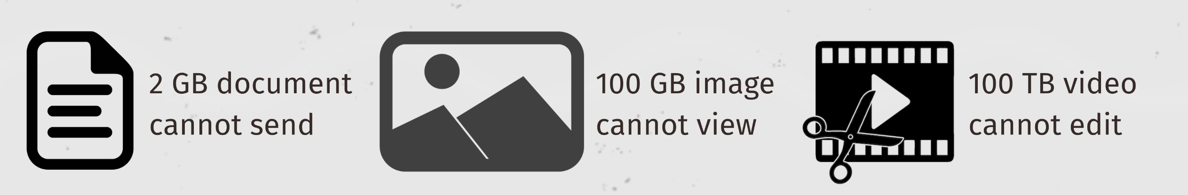
Big Data – Definition
"deals with data sets that are too large or complex to be handled by traditional systems"
Big Data is not only about size
Volume
Size of the data
Velocity
Speed of data creation, storage, analysis and visualization
Variety
Data comes in different formats (90% of data is unstructured)

Slide 6
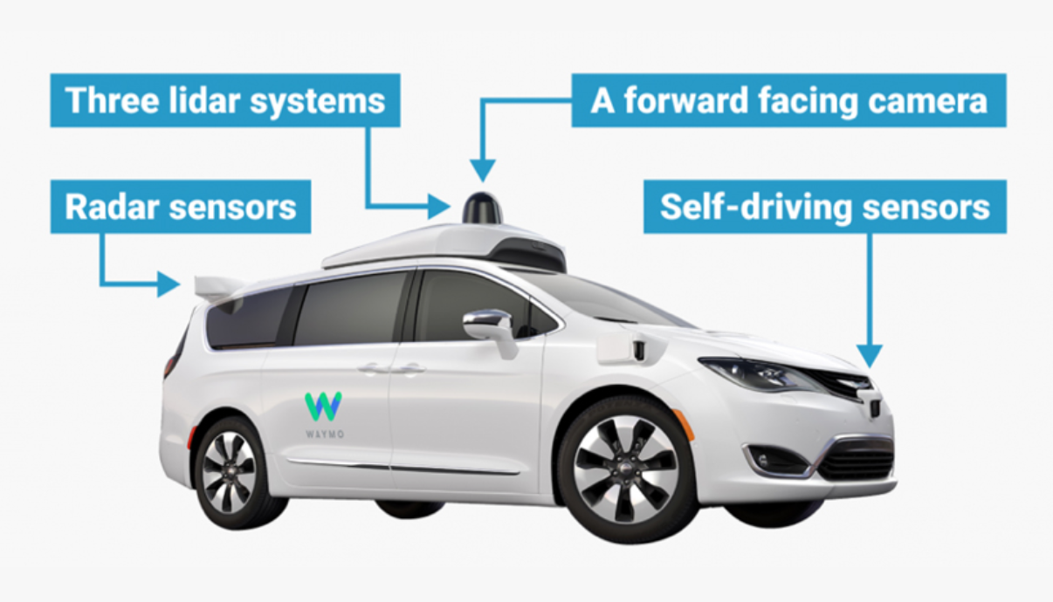



Example – Self-driving Cars
Volume
Petabytes of sensor data
Velocity
High-speed collection of sensor data
High-speed processing
Variety
Sensor data
Image recognition
Log files
Collect
store securely
and inexpensively
Analyze
find
connections
Understand
get
insights

Slide 7
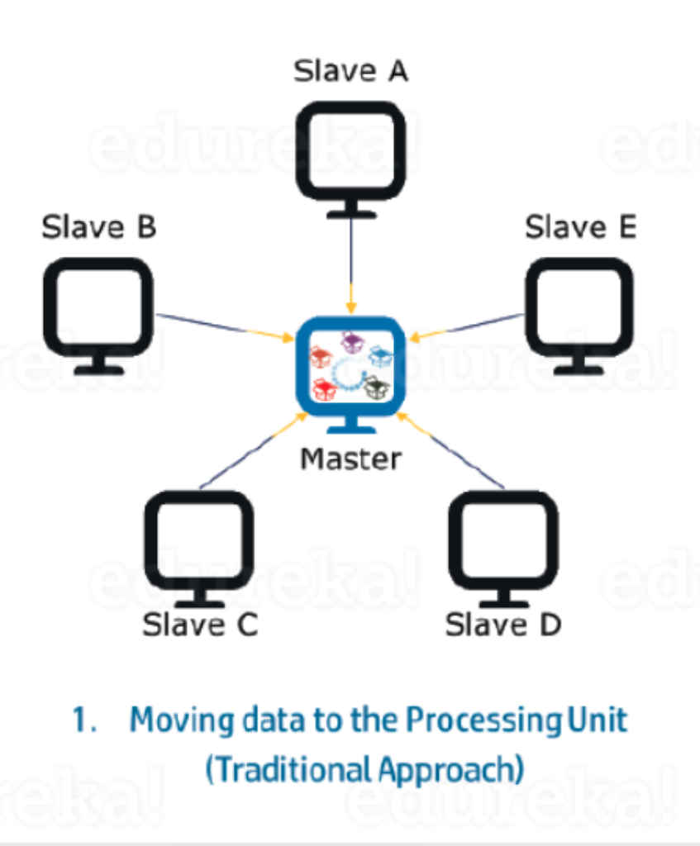
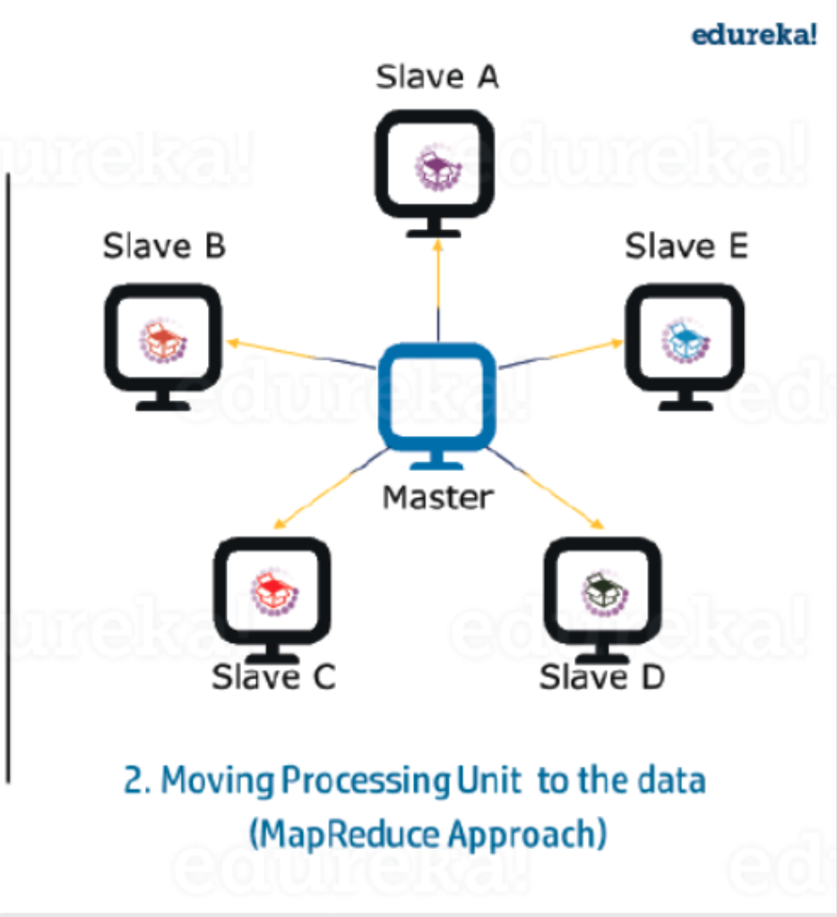
Idea – Data Locality
Idea
Move the code
instead of the data
Advantages
Much less data to transfer
Parallel processing

Slide 8
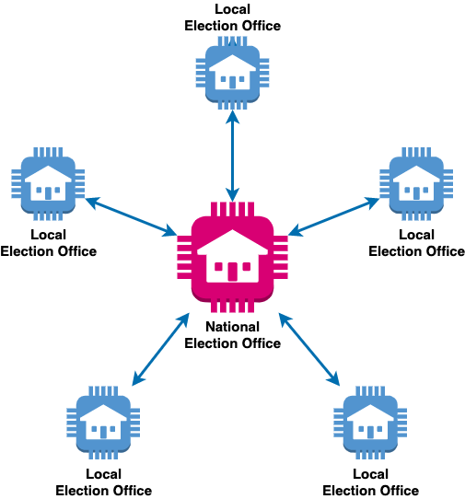
Data Locality Example – National Elections
Traditional computing
Move the data to the algorithm
National office counts the votes
Distributed computing (map-reduce)
Move the algorithm to the data
Local offices process their data (map)
National office summarizes the data (reduce)
National office has the algorithm
Local offices have the data

Slide 9

HADOOP

Slide 10
What is Hadoop?
An open-source software platform
… for distributed storage
… and distributed processing
… of very large datasets
… on computer clusters built from commodity hardware
History:
Based on GFS (Google File System) and MapReduce papers published by Google in 2003-2004
Originally built by Yahoo! as an open-source web search engine
Development driven by Doug Cutting & Tom White
Initial release: 2006

Slide 11
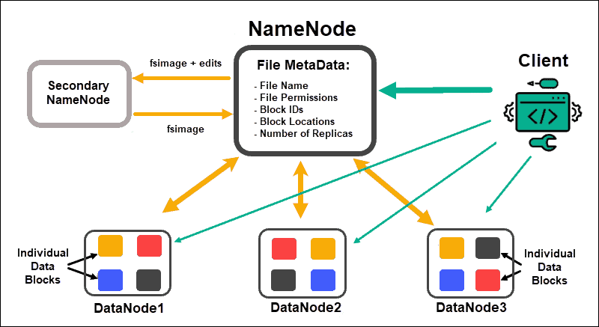
HDFS – Distributed File System
Files are partitioned and replicated
Optimized for large files
Breaks them into 128 Mb blocks
Many small files is an anti-pattern
NameNode: table of contents
DataNodes: contain the file chunks
hdfs dfs -mkdir /user/dir1
hdfs dfs -ls /user/dir1
hdfs dfs -put /home/localfile /user/dir1
hdfs dfs -cat /user/dir1/localfile

Slide 12
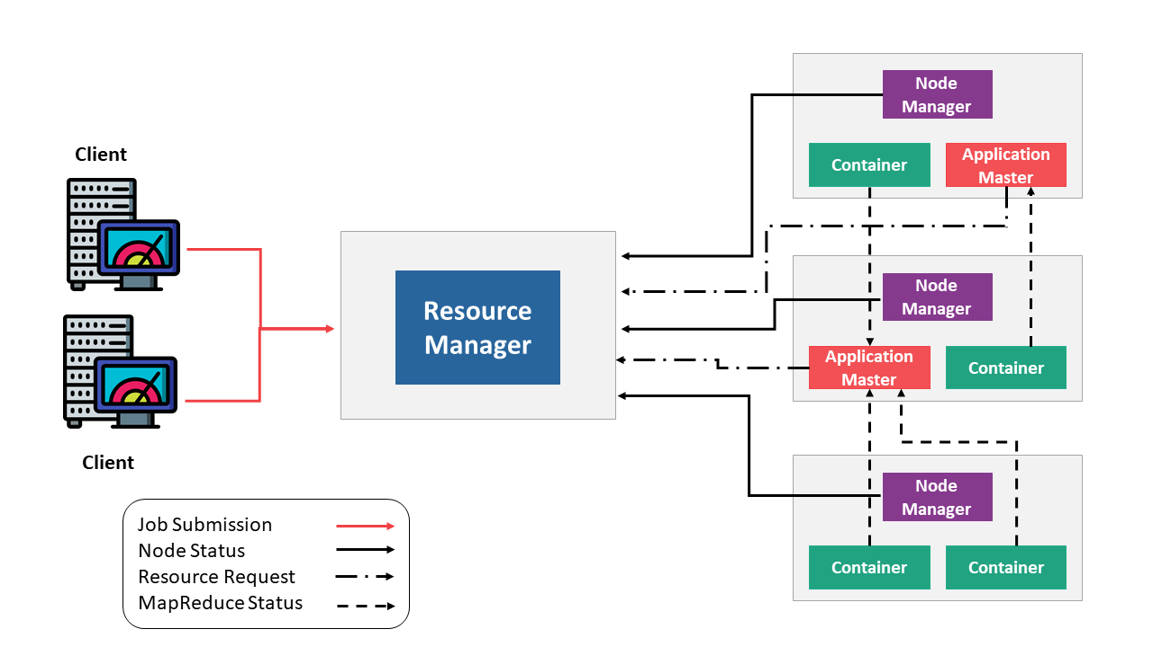
YARN – Distributed Computing
YARN: Yet Another Resource Negotiator
A framework for job scheduling and cluster resource management.
Resource Manager
Maintains a process overview
Designates resources to applications
Scheduling workloads
Node Manager
Tracks resources on the node
Acts as a slave for Resource Manager

Slide 13
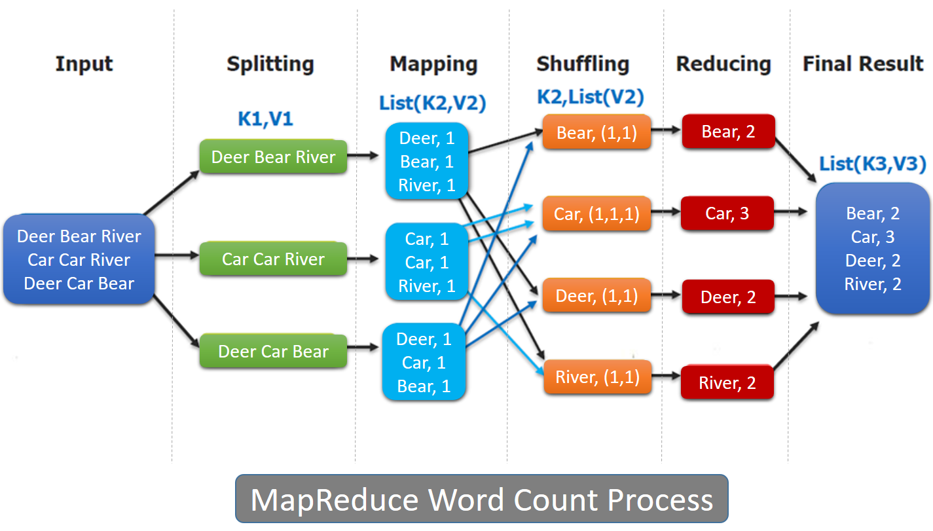
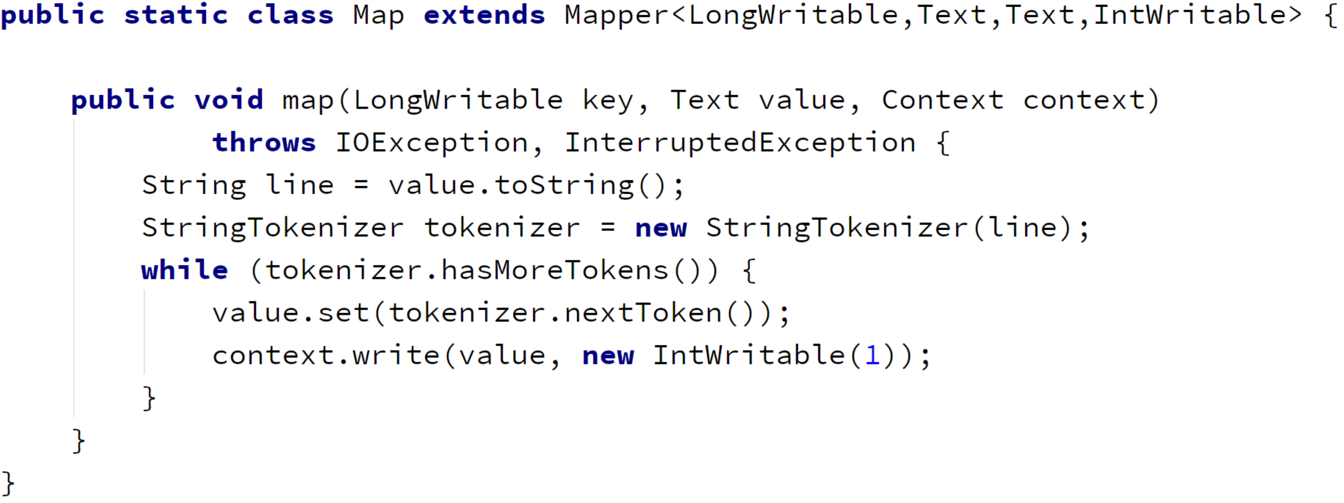
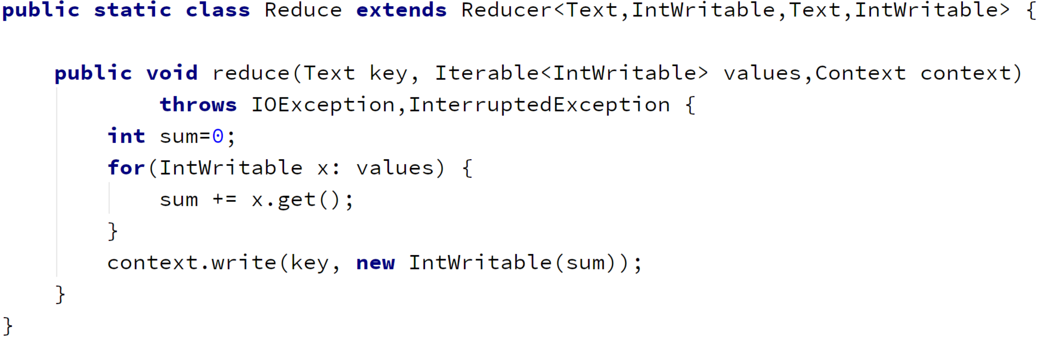
MapReduce – Programming Framework
MapReduce: A YARN-based system for parallel processing of large data sets.

Slide 14
MapReduce – MAP

Slide 15
MapReduce – REDUCE

Slide 16
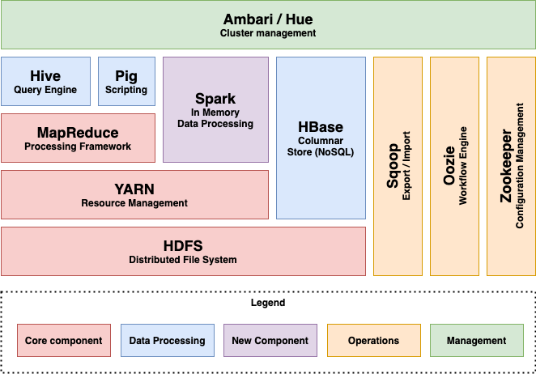

Hadoop Components
Components are changing
Some loosing relevance
(Pig, Oozie, Mahout, ...)
Others are added
(Spark, Presto, ...)
Many applications work together
(Cassandra, Airflow, ...)
Apache Hadoop
Architecture Explained

Slide 17
Hive – SQL Interface
Data Warehouse software
… for reading, writing, and managing large datasets
… residing in distributed storage
… using SQL
CREATE EXTERNAL TABLE User(
first_name VARCHAR(64),
last_name VARCHAR(64),
company_name VARCHAR(64),
address STRUCT<zip:INT, street:STRING>,
country VARCHAR(64),
city VARCHAR(32),
state VARCHAR(32),
post INT,
phone_nos ARRAY<STRING>,
mail MAP<STRING, STRING>,
web_address VARCHAR(64)
)
COMMENT 'Temporary ORC table'
STORED AS ORCLOCATION '/user/hive/orc/user'
TBLPROPERTIES ("orc.compress"="SNAPPY");

Slide 18
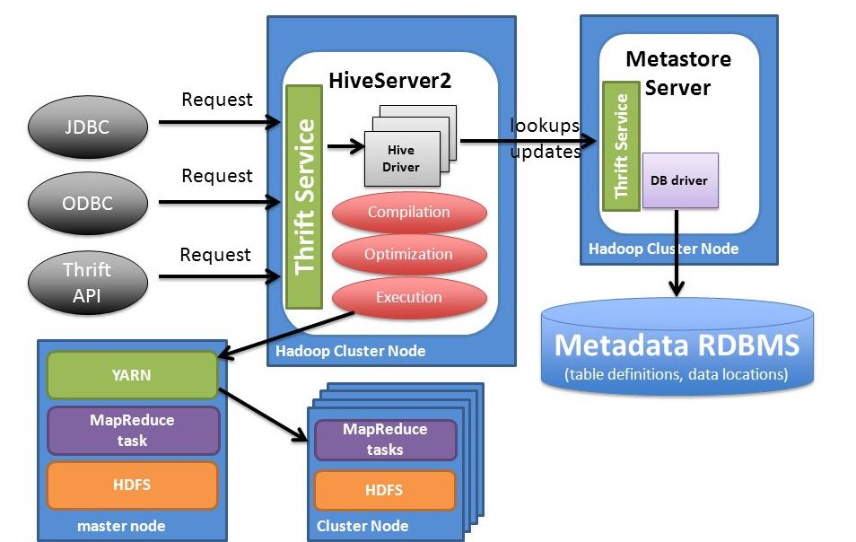
Hive – Architecture
Hive Metastore
Stores the schema info
Hive Server
Translates SQL to MapReduce
(or TEZ or Spark)

Slide 19
HIVE – PARTITIONS
Table definition
HDFS folders
CREATE TABLE by_month ( country string, iso_code string, day date, total_vaccinations float ) PARTITIONED BY (
year int, month int)
by_month/year=2020 by_month/year=2020/month=12 by_month/year=2021 by_month/year=2021/month=1 by_month/year=2021/month=2 by_month/year=2021/month=3

Slide 20


Hive – Features
Supports
A large subset of SQL
Complex data types (arrays, structs, maps)
Views
Indexing
Partitioning
Bucketing
User-defined functions
Sampling
Explain
Optimization hints
Hive is
NOT a relational database
NOT designed for OLTP
(on-line transaction processing)
NOT real-time
(not even with small amounts of data)

Slide 21
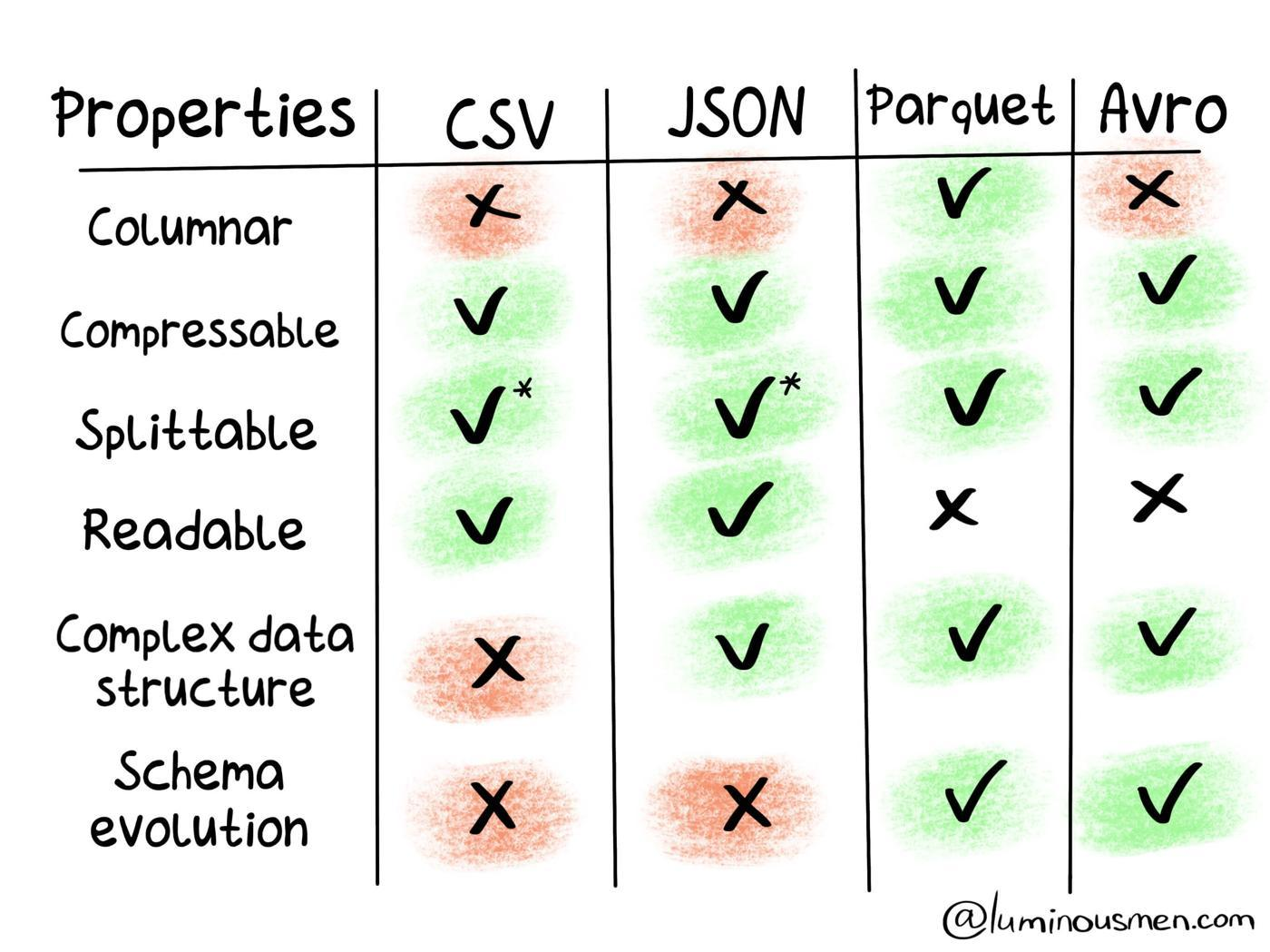
File Formats
Columnar format
Data is stored by column, not row
Read optimization
Compression improvements
Schema evolution
Supports schema changes
Big Data File Formats

Slide 22





Hadoop Distributions
Hadoop is a software package
Components are open-source and free
Distributions are tested packages with optional support
Google Cloud
DataProc
Microsoft Azure
HDInsight

Slide 23

HADOOP – Take Away
Concept of MapReduce (Elections)
Distributed Storage (HDFS)
Distributed Computing (YARN + MapReduce)
Hive: SQL on distributed files
Hive metastore: Schema definition of files

Slide 24

Spark

Slide 25



Spark
Lightning-fast unified analytics engine for large-scale data processing
Distributed computing
Not a data store - but can integrate with them
Not for OLTP

Slide 26
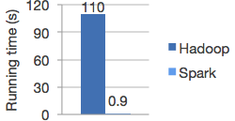
Spark
Lightning-fast unified analytics engine for large-scale data processing
Distributed
In-memory
On iterative processing
High-level optimizations

Slide 27
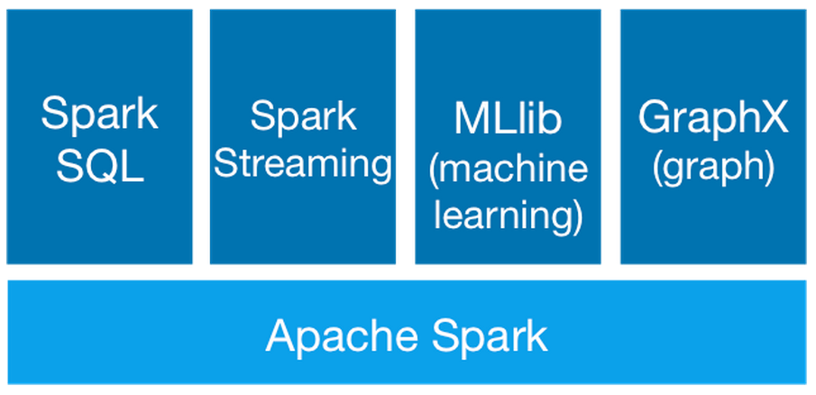
Spark
Lightning-fast unified analytics engine for large-scale data processing

Slide 28
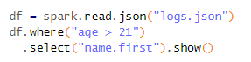
Spark
Easy to use
High level operations
Supports
several programming languages (Java, Scala, Python, R, SQL)
Many data stores (HDFS, Hive, HBase, Cassandra, ...)
Interactive shell

Slide 29

Data Collections & operations

Slide 30
RDD (Resilient Distributed Dataset)
Distributed collection of data
Rebuild on failure
Immutable
Built via parallel transformations
RDD
Partition
Partition
Partition
Partition
Partition
Node
Node
Node

Slide 31
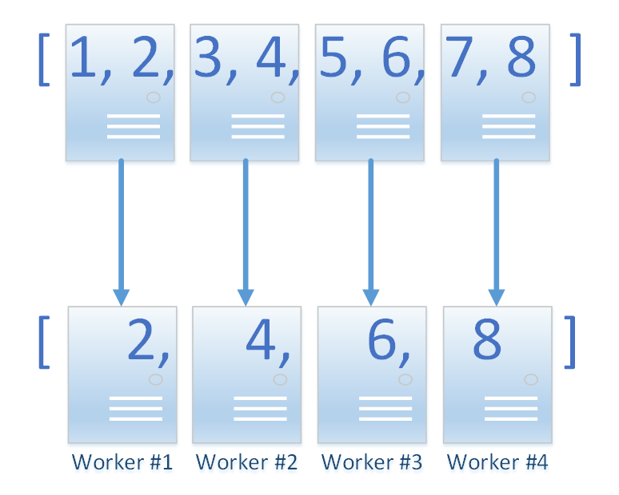
RDD – OPERATIONS
.filter(_.isEven)
DATA LOCALITY

Slide 32
Transformations & actions
Transformations
Creates new data collection
Lazy evaluation
Example:
map
filter
group by
join
RDD
RDD
RDD
Actions
Creates result
Triggers execution
Example
count
collect
write
RDD
Result

Slide 33
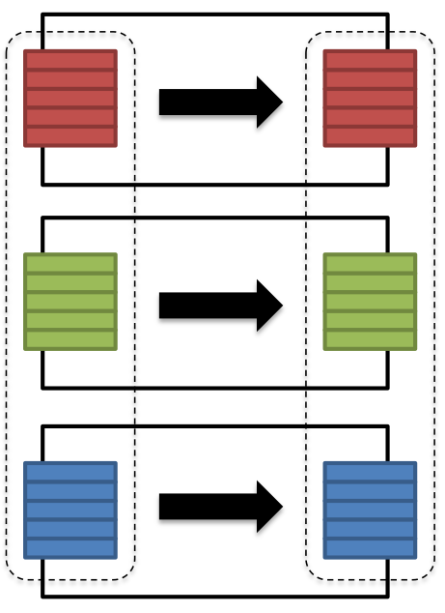
Transformations
Narrow transformations
Input and output stays in same partition
Parallel execution
Pipelining
Example
Map
Filter

Slide 34
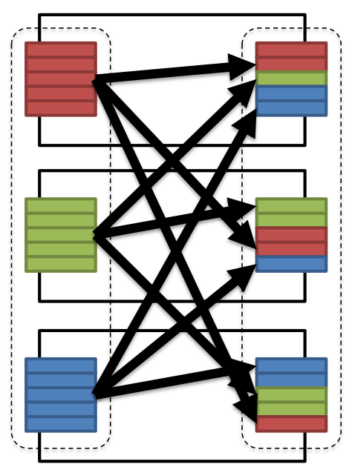
Transformations
Wide transformations
Input from other partitions required
Needs expensive data shuffling
Serialization, disk & network I/O
Examples
Group by
Repartition

Slide 35
Transformations
Joins
Shuffle join
Broadcast join

Slide 36
Cache (Persist)
Optimization technique
Avoid recomputation on
Data reuse
Failure
Key on iterative algorithms
RDD
RDD
RDD
RDD

Slide 37

Apis

Slide 38
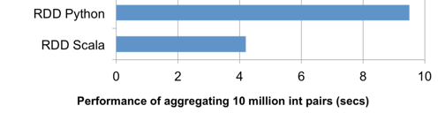
RDD
Primary API in Spark 1.X
Functional
Records are raw objects
Compile time type safety
User controlled partitioning and storage
val lines = sc.textFile(@"hdfs://path/words.txt")
val processed = lines
.filter(s => s.startsWith("a"))
.map(s => s.reverse)
.sortBy(s => s.length)
Limitations
Low level, non-expressive API
No higher level optimization
I/O handling is limited and can be cumbersome
Low performance on non-JVM languages

Slide 39
Dataframes
Higher level abstraction on top of RDD
Schema: named columns with types
Conceptually like an RDMS table
SQL-like declarative API
val persons = spark.read.json("test.json")
val names = lines
.where("age > 21")
.select("name.first")
names.show()
Columns
Col1 | Col2 | Col3
Partitions
Rows

Slide 40
Data Types
Primitive types
ByteType, ShortType, IntegerType, LongType
FloatType, DoubleType, DecimalType
StringType, VarcharType, CharType
BinaryType
BooleanType
TimestampType, DateType
Complex types
ArrayType
MapType
StructType, StructField
own optimized types

Slide 41
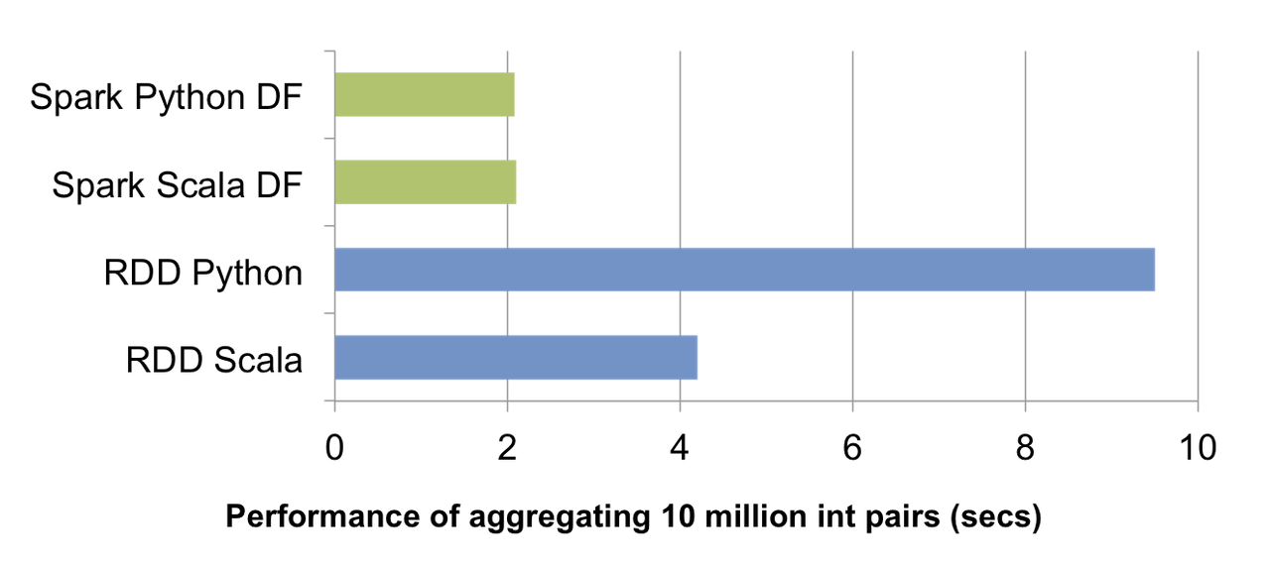
Dataframes
Expressive high level operations and functions
Language interoperability (no performance loss)
Automatic optimizations
Powerful I/O handling (Datasource API)
No compile time type safety
val persons = spark.read
.json("persons.json")
val names = persons
.where("age > 21")
.select("name.first")
names.show()

Slide 42
Datasets
Available in Scala and Java
Strongly typed domain objects + encoders
DataFrames are actually Datasets of type Row
case class Person(
id: String,
firstName: String,
lastName: String,
age: Int
)
val persons =
spark.read.json("persons.json")
.as[Person]
val names = persons
.filter(_.age > 21)
.select("firstName")
names.show()
Both relational and functional operations
High level optimizations
Data source API
Compile type safety
Encoding has performance penalty

Slide 43
Spark SQL
Programmatic SQL
ThriftServer
persons.createOrReplaceTempView("people")
val names = spark.sql(
"SELECT name.first FROM people WHERE age > 21"
)
names.show()
JDBC
ODBC
Thrift JDBC/ODBC server
CLI
spark-sql> _

Slide 44

Spark SQL
Features
Subset of ANSI SQL
Managed & unmanaged tables
Complex types
Catalog
Views
Partitioning & bucketing
User defined functions
Cache tables
Etc.
VS

Slide 45
Spark – Take Away
Distributed, fault-tolerant dataset
Fast, mostly in-memory execution
Four different API with pros and cons
Structured APIs provide high level operations and optimizations

Slide 46

BREAK

Slide 47

Workshop

Slide 48
Environment
Source available on
david-szabo-epam/spark-workshop

Slide 49
DataSources
Builder
Default formats
Several file types (CSV, JSON, Partquet, Avro, etc.)
SQL (JDBC/ODBC)
Hive
Available via Libraries:
Cassandra
MongoDB
Hbase
AWS Redshift
Many others
Schema inference
Smart sources
Query pushdown
spark.read
.format("csv")
.option("mode", "FAILFAST")
.option("header", "true")
.schema(someSchema)
.load("/data/test-data2021.csv")
dataframe.write
.format("csv")
.option("mode", "OVERWRITE")
.option("sep", "\t")
.save("/data/test-output.tsv")

Slide 50
Choosing API
DataFrame
Can be a good default choice
Full compile time safety not needed
For best general performance
Dataset
Cannot be expressed in DataFrame manipulations
Need or want compile time safety
Performance penalty is acceptable
SQL query
When it is easier to express fully in SQL
RDD
Generally avoid
Maintaining legacy applications
Low level features (e.g. custom partitioning)
General considerations
Personal, team and project preferences are factor
You can change between APIs

Slide 51
Workshop – Take Away
Prefer structured APIs
APIs are interoperable
Datasource API
Spark UI to monitor your jobs
Execution plans can be checked via command and UI

Slide 52


Questions?

